Slide 1

Telecom Customer Churn Analysis using Data Mining
Domain: Data Mining
Student Name: ________
Supervisor: ________

Slide 2

Introduction
Customer churn is a major problem in the telecom industry
Losing customers directly impacts revenue and growth
Data mining helps analyze large customer datasets
This project predicts churn to support retention strategies

Slide 3
Problem Statement
Telecom companies face high customer attrition
Manual analysis is inefficient and time-consuming
Need for automated churn prediction system
Goal: Identify customers likely to churn

Slide 4
Project Objectives
01
02
03
Analyze telecom customer data
Identify key factors influencing churn
Build multiple classification models
04
05
Compare model performance
Predict churn for new customers

Slide 5




SDG Alignment
Sustainable Development Goal 9 (Industry, Innovation & Infrastructure)
Promotes digital innovation
Encourages data-driven decision making
Improves operational efficiency
Supports intelligent telecom infrastructure

Slide 6

Dataset Overview
Telecom customer dataset
Includes customer usage and service details
Target variable: Churn (Yes/No)
Dataset processed and cleaned before modeling

Slide 7






Methodology
Data ingestion and exploration
Data preprocessing
Feature engineering
Model training
Model evaluation
Model inference

Slide 8
Machine Learning Models Used
(Used as data mining classification techniques)
Logistic Regression
Decision Tree
Random Forest
K-Nearest Neighbors (KNN)
Support Vector Machine (SVM)

Slide 9

Model Evaluation
Accuracy
Precision
Recall
F1-Score
ROC-AUC Curve
Confusion Matrix

Slide 10
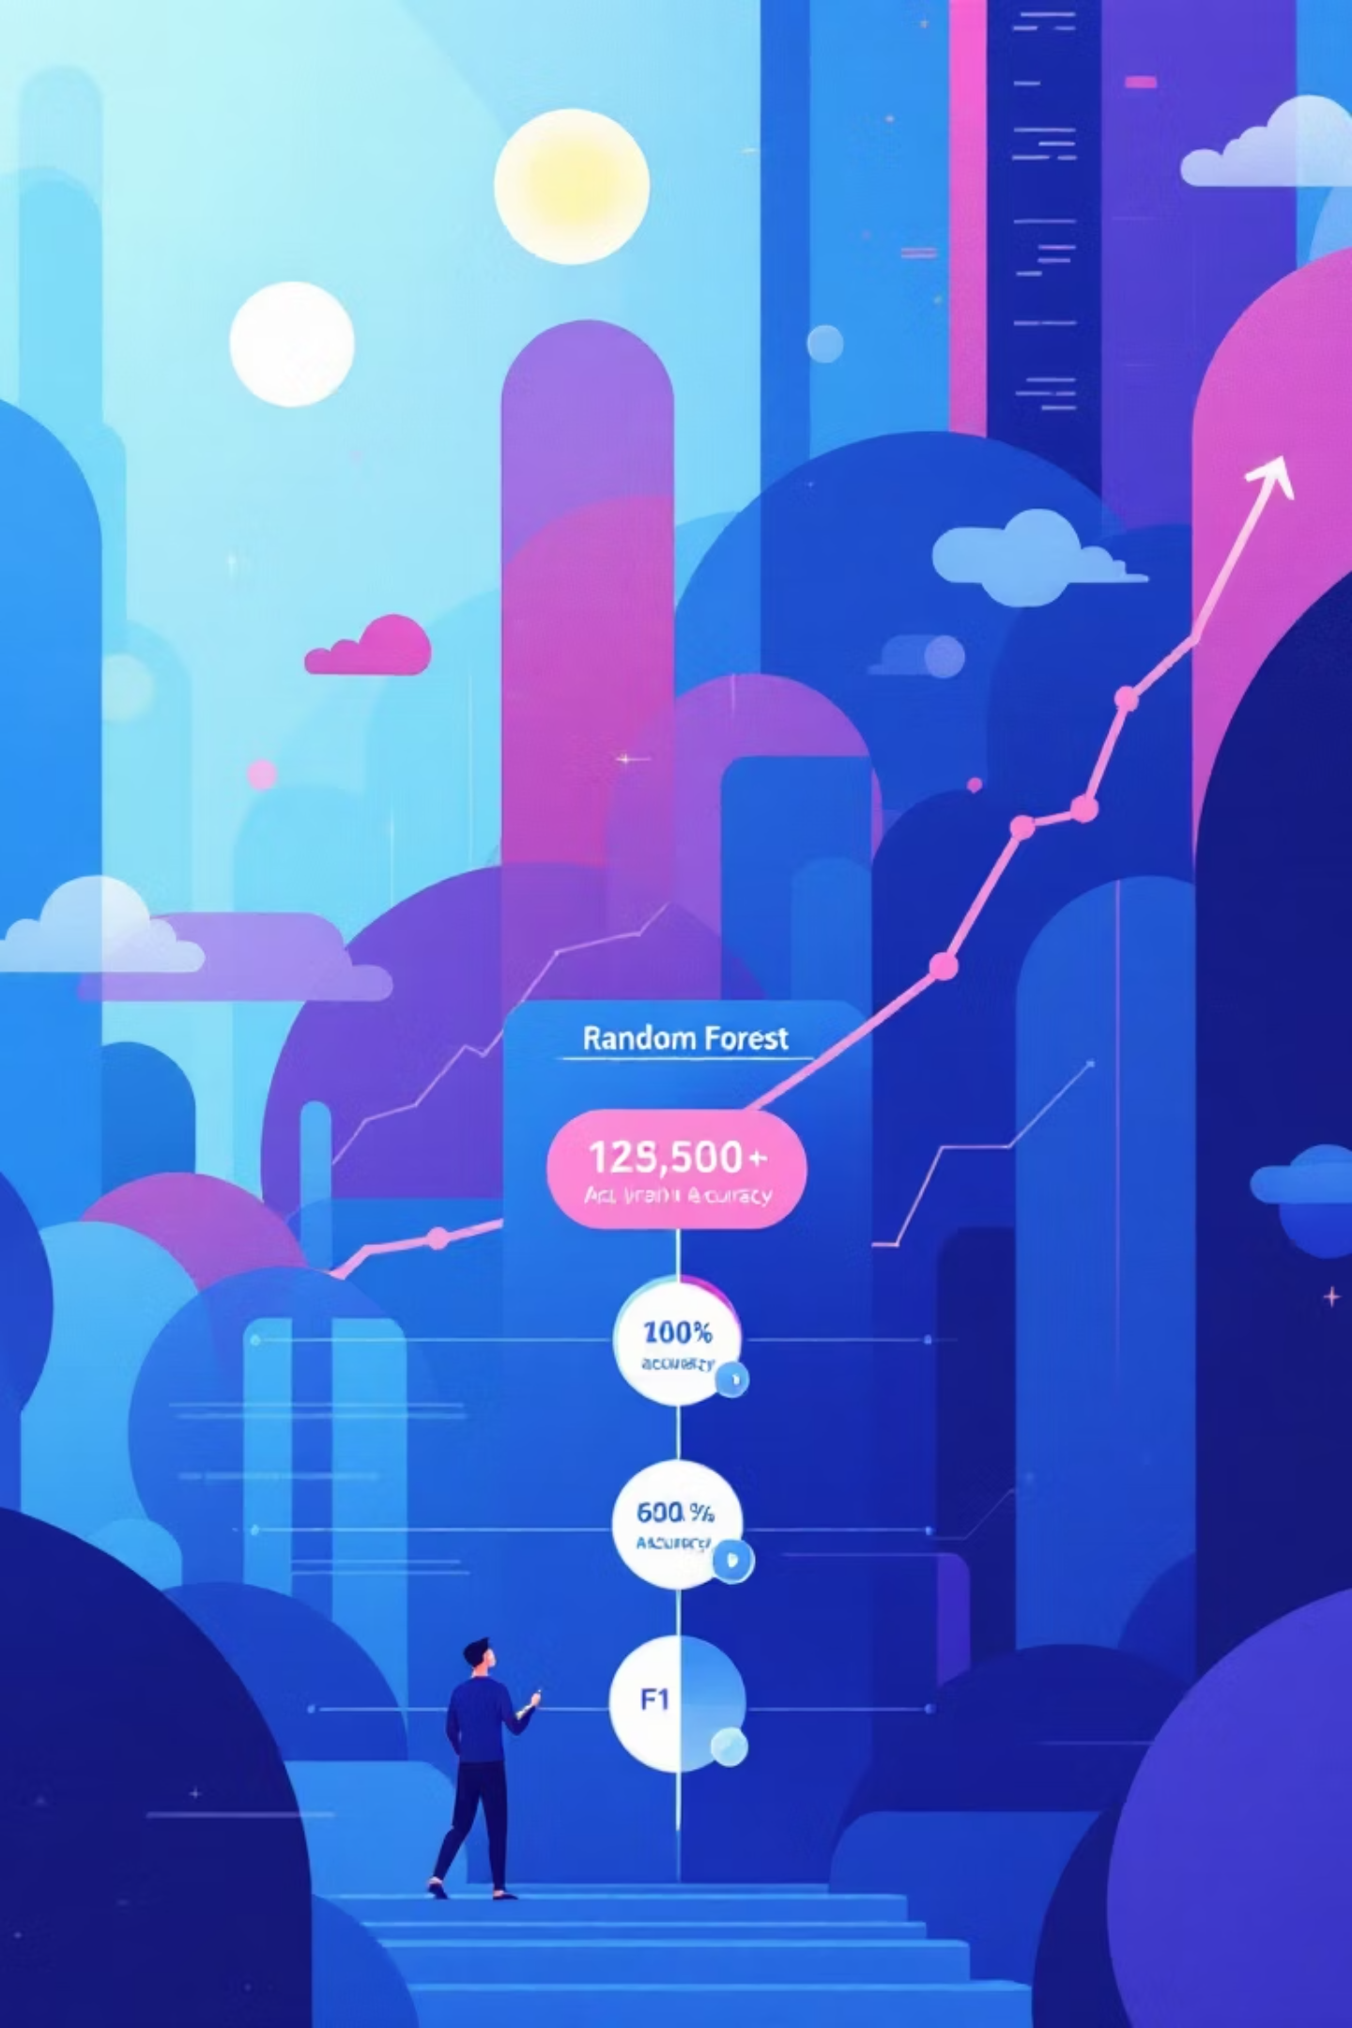
Results & Best Model
All models compared
Random Forest achieved best performance
High accuracy and F1-score
Selected as final model

Slide 11
Demo Video
Demonstrates:
Loading dataset
Running trained models
Evaluating results
Predicting churn for new customers
(Demo video shown during presentation)

Slide 13



Business Benefits
Reduced customer churn
Improved customer retention
Data-driven marketing strategies
Increased revenue stability

Slide 14
Challenges Faced
Handling missing values
Feature selection
Model comparison
Class imbalance

Slide 15

Conclusion
Data mining effectively predicts customer churn
Multiple models improve reliability
Project supports business decision making
Solution is scalable and practical

Slide 16
QnAs
Q: Why churn prediction is important? A: It helps reduce customer loss and revenue decline.
Q: Why multiple models were used? A: To compare performance and select the best classifier.

Slide 17

Thank You
Questions?

